Slide 1
Software Testing and Quality Assurance
Theory and Practice
Chapter 14
Acceptance Testing
Notes:
Handouts
------------------------------------------------------------------
------------------------------------------------------------------
-------------------------------------------------------------------
--------------------------------------------------------------------

Slide 2
Outline of the Chapter
Types of Acceptance Testing
Acceptance Criteria
Selection of Acceptance Criteria
Acceptance Test Plan
Acceptance Test Execution
Acceptance Test Report
Acceptance Testing in eXtreme Programming
Notes:
Handouts

Slide 3
Types of Acceptance Testing
Acceptance testing is a formal testing conducted to determine whether a system satisfies its acceptance criteria
There are two categories of acceptance testing:
  User Acceptance Testing (UAT)
    It is conducted by the customer to ensure that system satisfies the contractual acceptance criteria before being signed-off as meeting user needs.
  Business Acceptance Testing (BAT)
    It is undertaken within the development organization of the supplier to ensure that the system will eventually pass the user acceptance testing.
Notes:
Handouts

Slide 4
Types of Acceptance Testing
Three major objectives of acceptance testing:
Confirm that the system meets the agreed upon criteria
Identify and resolve discrepancies, if there is any
Determine the readiness of the system for cut-over to live operations
Notes:
Handouts

Slide 5
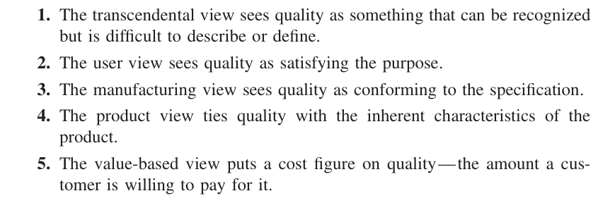
Notes:
"The application interface must feel 'premium' and provide a seamless, elegant user experience that inspires total financial confidence.“
"A customer must be able to complete an emergency fund transfer to a saved contact in under 30 seconds, even when using a one-handed interface.“
"The system must support the ISO 20022 payment messaging standard and ensure that the transaction log exactly matches the data fields defined in the Functional Requirement Document (FRD) v1.2.“
"The application must support Biometric Authentication (FaceID/Fingerprint), 256-bit AES encryption, and multi-currency account displays.“
"The Lite version of the app must provide basic balance checks and transfers for a $0 monthly fee, while the Pro version provides investment tracking for a $5 monthly fee with 99.99% uptime."
Handouts

Slide 6
Acceptance Criteria
The acceptance criteria are defined on the basis of the following attributes:
  Functional Correctness and Completeness
  Accuracy
  Data Integrity
  Data Conversion
  Backup and Recovery
  Competitive Edge
  Usability
  Performance
  Start-up Time
  Stress
  Reliability and Availability
  Maintainability and Serviceability
  Robustness
  Timeliness
  Confidentiality and Availability
  Compliance
  Installability and Upgradability
  Scalability
  Documentation
Notes:
Handouts

Slide 7
Selection of Acceptance Criteria
The acceptance criteria discussed are too many and very general
The customer needs to select a subset of the quality attributes
The quality attributes are prioritize them to specific situation
IBM used the quality attribute list CUPRIMDS for their products
  – Capability, Usability, Performance, Reliability, Installation, Maintenance, Documentation, and Service
Ultimately, the acceptance criteria must be related to the business goals of the customer’s organization
Notes:
Handouts

Slide 8
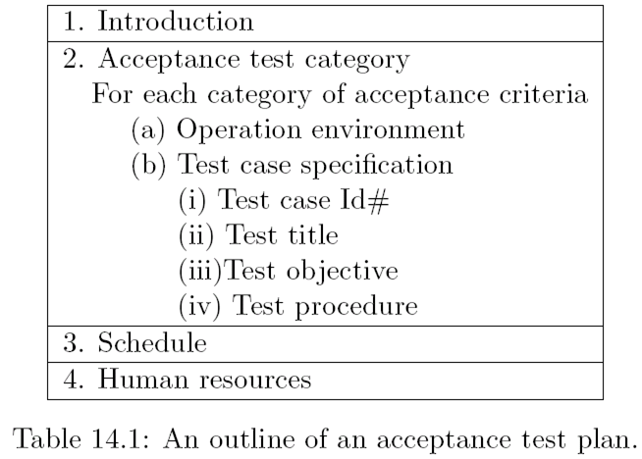
Acceptance Test Plan
Notes:
Handouts

Slide 9
Acceptance Test Execution
The acceptance test cases are divided into two subgroups
  The first subgroup consists of basic test cases, and
  The second consists of test cases that are more complex to execute
The acceptance tests are executed in two phases
  In the first phase, the test cases from the basic test group are executed
  If the test results are satisfactory then the second phase, in which the complex test cases are executed, is taken up.
  In addition to the basic test cases, a subset of the system-level test cases are executed by the acceptance test engineers to independently confirm the test results
Acceptance test execution activity includes the following detailed actions:
  The developers train the customer on the usage of the system
  The developers and the customer co-ordinate the fixing of any problem discovered during acceptance testing
  The developers and the customer resolve the issues arising out of any acceptance criteria discrepancy
Notes:
Handouts

Slide 10
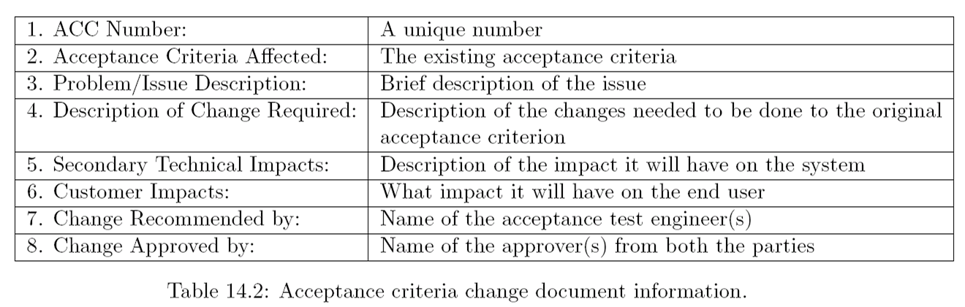
Acceptance Test Execution
The acceptance test engineer may create an Acceptance Criteria Change (ACC) document to communicate the deficiency in the acceptance criteria to the supplier
A representative format of an ACC document is shown in Table 14.2.
An ACC report is generally given to the supplier’s marketing department through the on-site system test engineers
Notes:
Handouts

Slide 11
Acceptance Test Report
The acceptance test activities are designed to reach at a conclusion:
  accept the system as delivered
  accept the system after the requested modifications have been made
  do not accept the system
Usually some useful intermediate decisions are made before making the final decision.
  A decision is made about the continuation of acceptance testing if the results of the first phase of acceptance testing is not promising
  If the test results are unsatisfactory, changes be made to the system before acceptance testing can proceed to the next phase
During the execution of acceptance tests, the acceptance team prepares a test report on a daily basis
A template of the test report is given in Table 14.3
At the end of the first and the second phases of acceptance testing an acceptance test report is generated which is outlined in Table 14.4
Notes:
Handouts

Slide 12
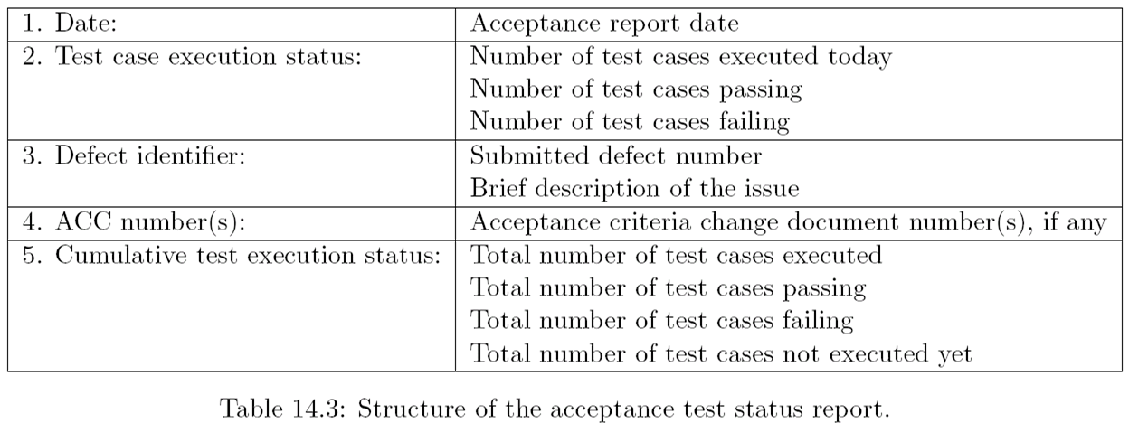
Acceptance Test Report
Notes:
Handouts

Slide 13
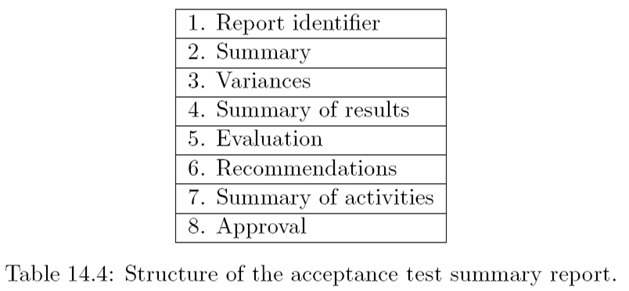
Acceptance Test Report
Notes:
Handouts

Slide 14
Acceptance Testing in eXtreme Programming
In XP framework the user stories are used as acceptance criteria
The user stories are written by the customer as things that the system needs to do for them
Several acceptance tests are created to verify the user story has been correctly implemented
The customer is responsible for verifying the correctness of the acceptance tests and reviewing the test results
A story is incomplete until it passes its associated acceptance tests
Ideally, acceptance tests should be automated, either using the unit testing framework, before coding
The acceptance tests take on the role of regression tests
Notes:
Handouts

